Slide 1
Heber Valley Office of Tourism
Three-season Campaign 2019

Slide 2
WHO WE ARE
Full-service advertising & marketing agency
Specialize in tourism
7 years working with DMOs
Located in downtown Provo
Built to drive TRT

Slide 3
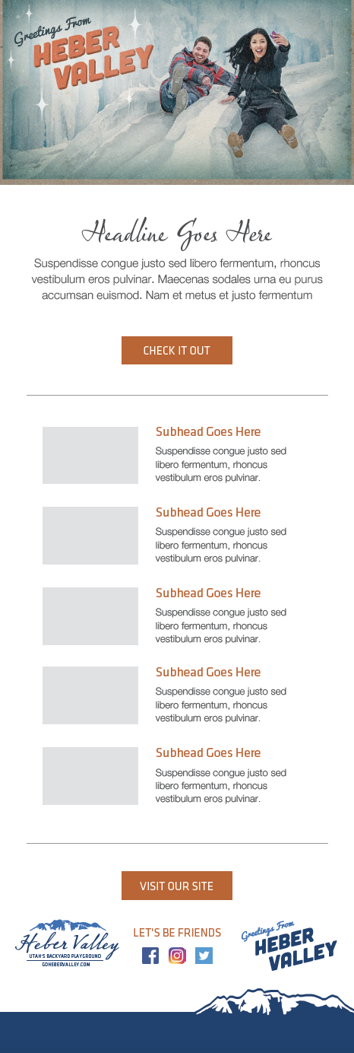
PREVIOUS WORK FOR HEBER VALLEY

Slide 4
HEBER VALLEY THREE-SEASON CAMPAIGN 2019
Campaign Goals
Drive visitation in the off-seasons (Spring, Summer, Fall)
Increase overall awareness of Heber Valley
Establish recognizable branding

Slide 5
HEBER VALLEY THREE-SEASON CAMPAIGN 2019
Campaign Strategies
Promote awareness through multi-channel advertising campaigns
Increase interest and awareness through public relations
Increase interest and awareness through social media & influencers
Design and develop creative campaigns and branding that are easily-recognizable and memorable
Utilize marketing automation to continue to engage potential visitors after first contact

Slide 6
HEBER VALLEY THREE-SEASON CAMPAIGN 2019
Campaign Tactics
PR & Content
Monthly blog posts
Monthly email newsletters
Social media influencers - June or July
Purpose: Drive Awareness & Interest

Slide 7
HEBER VALLEY THREE-SEASON CAMPAIGN 2019
Campaign Tactics
SEO & SEM
Targeted SEM campaigns
Search-engine-optimize the Heber Valley website
Purpose: Promote Awareness, Increase Visitation

Slide 8
HEBER VALLEY THREE-SEASON CAMPAIGN 2019
Campaign Tactics
Facebook & Instagram Ads
Lead gen ads
Carousel ads
Purpose: Promote Awareness, Increase Visitation

Slide 9
HEBER VALLEY THREE-SEASON CAMPAIGN 2019
Campaign Tactics
Retargeting
Dynamic display ads
Messaging based on interests
Purpose: Increase Visitation, Encourage Action

Slide 10
HEBER VALLEY THREE-SEASON CAMPAIGN 2019
Campaign Tactics
Email Automation
Monthly email newsletters
Email marketing nurtures
Provide several touchpoints
Purpose: Increase Visitation, Encourage Action

Slide 11
HEBER VALLEY THREE-SEASON CAMPAIGN 2019
Additional Services
Creative Services
Ad campaign creation
Branding development
General design needs
Administrative Services
Account management
Market research - Wonder
Real-time dashboards

Slide 12
QUESTIONS?

